Slide 1
Feature Engineering in Time Series Analysis
Specify of features in time series analysis.
Specify of exploratory data analysis;
Some methods for representing of features in time series analysis;
Review of methods for extracting features from time series;
Some methods of feature processing in time series analysis.

Slide 2
Feature Engineering In Time Series Analysis
Feature Engineering can be defined as the process of selection and pre-processing meaning-full features and eliminating features from the time series that are irrelevant to the task.
More generally feature engineering includes the following tasks.
Exploratory Data Analysis, EDA (data visualization, preliminary manual analysis (unsupervised), e.t.c.
Feature Representation (and Time Series Representation),(trend-seasonal decomposition, bag of words, spectrum domain, wavelet decomposition, acf, e.t.c.).
Feature Extraction (trend-seasonal-irregualr (residual) part decomposition, PCA, SSA, Intrinsic mode decomposition, Auto-encoder based extraction, representation learning, ARIMA approximation).
Feature Transformation (and Time Series Transformation), (Box-Cox transform, differencing, trend linearization or elimination, seasonality elimination, data normalization).
Feature Selection (filtering methods, wrappped methods).
Data Anomaly Detection(novelty detection, outliers missing values).
Data Denosing (same as feature extraction but only for such process as white noise and e.t.c.).
Feature engineering facilitates data understanding, reduces the computational time and storage requirements, so that model learning becomes an easier process. As usual, it can allow increasing accuracy of farther processing.

Slide 3
Exploratory Data Analysis (EDA)
Exploratory Data Analysis (EDA)
EDA refers to the critical process of performing initial investigations on data so as to discover patterns, to spot anomalies, to test hypothesis and to check assumptions with the help of summary statistics and graphical representations.
EDA includes such parameters estimation as:
Minimum, quartiles, Median, mean, Maximum values.
values deviation, normal-distribution hypnosis checking, skewness, kurtosis.
stationarity analysis (adf-test, ACF-PCF analysis).
data dependences analysis for multivariate data (correlation, causality analysis).
data visualization (box-plot, histogram-distribution, scatterplot).
missing and outliers value searching.

Slide 4
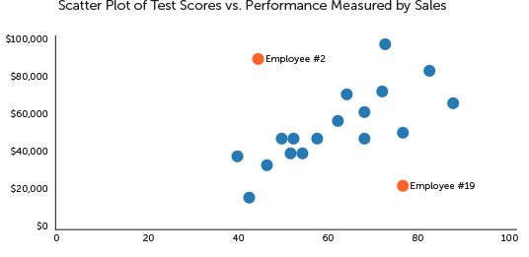
Exploratory Data Analysis (EDA). Examples
Example of scatterplot analysis.
A scatterplot can reveal data symmetry, clusters, correlation between variables, and extreme values or outliers.

Slide 5
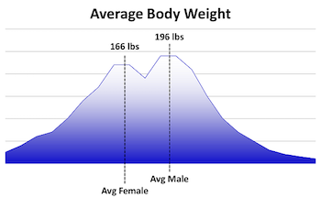
Exploratory Data Analysis (EDA). Examples
Example of histogram analysis.
Histogram represents the underlying structure in the form of a frequency distribution; that is, how often a particular value occurs.
Histograms help us see data symmetry, peaks, outliers or data error through omission. When multimodal histograms is presence (more than one peak), there's room to split the data.
For every peak, we can build a different model.

Slide 6
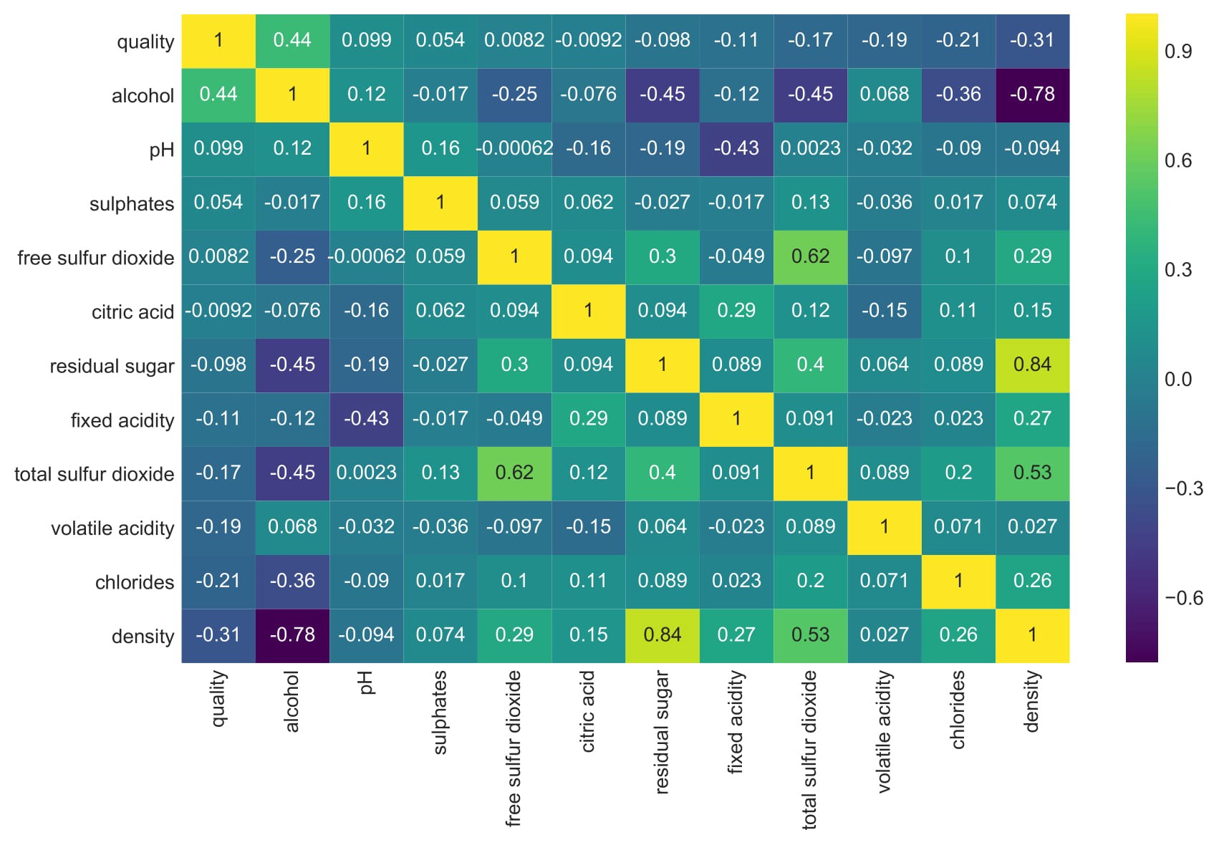
Exploratory Data Analysis (EDA). Examples
Example of correlation analysis - here we can eliminate features with high correlation or independent for our aim.

Slide 7
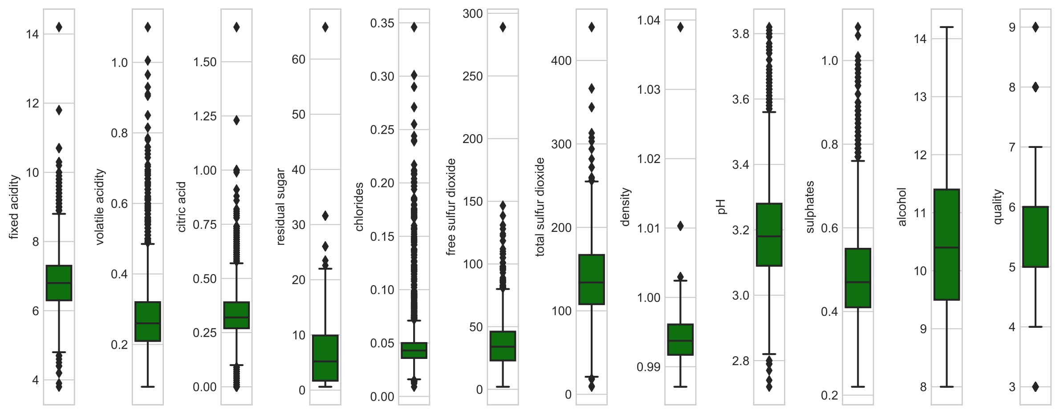
Exploratory Data Analysis (EDA). Examples
Example – BoxPlot.
The box plot (a.k.a. box and whisker diagram) is a standardized way of displaying the distribution of data based on the five number summary: Minimum, First quartile, Median, Third quartile, Maximum. The box plot allows one to estimate and delete anomalies.

Slide 8
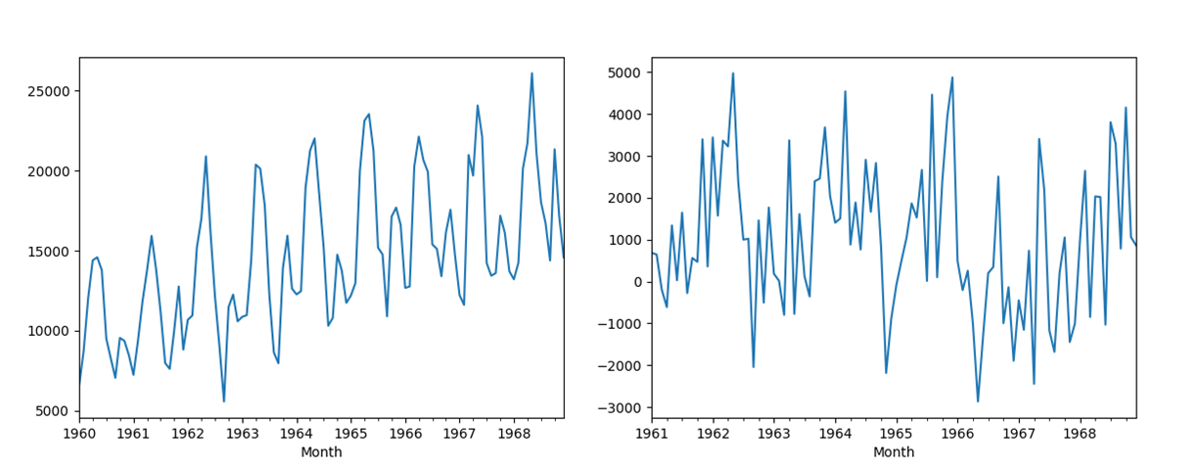
Exploratory Data Analysis (EDA). Examples
Example of check data stationary.
make data stationary by its difference.

Slide 9
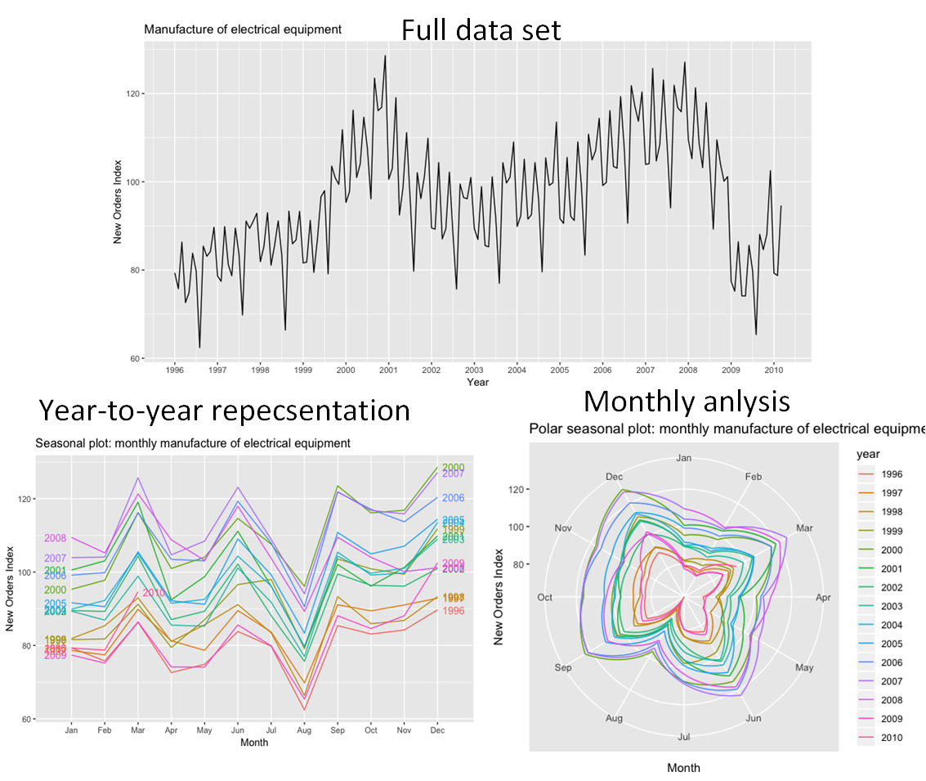
Exploratory Data Analysis (EDA). Examples
Example of seasonal dependency checking
we can see- year dependency by corresponding segmentation of the data.
It is also high monthly dependence is presence (especially in august, where are holidays).

Slide 10
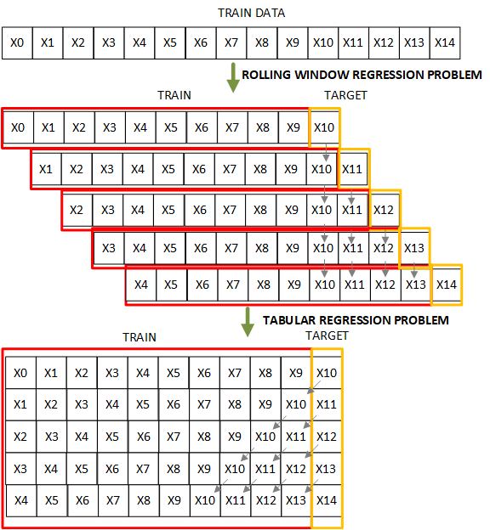
Feature Representation.
The better way to make forecast using conventional regression - is to use so-called Forecast Reduction technique, which is transformation of the implicitly accompanying long-horizon regression problem to the sliding window based problem.
This can be performed by method make_reduction as it is shown below.

Slide 11
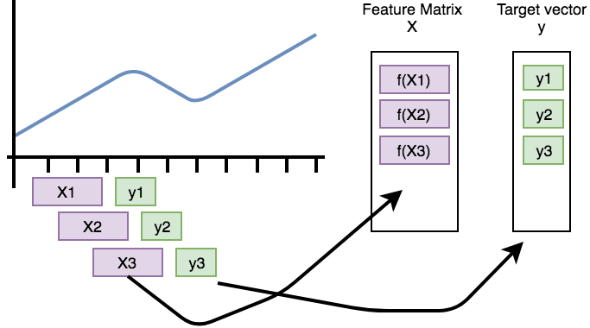
Feature Representation. Examples
Example of time series Rolling Representation

Slide 12
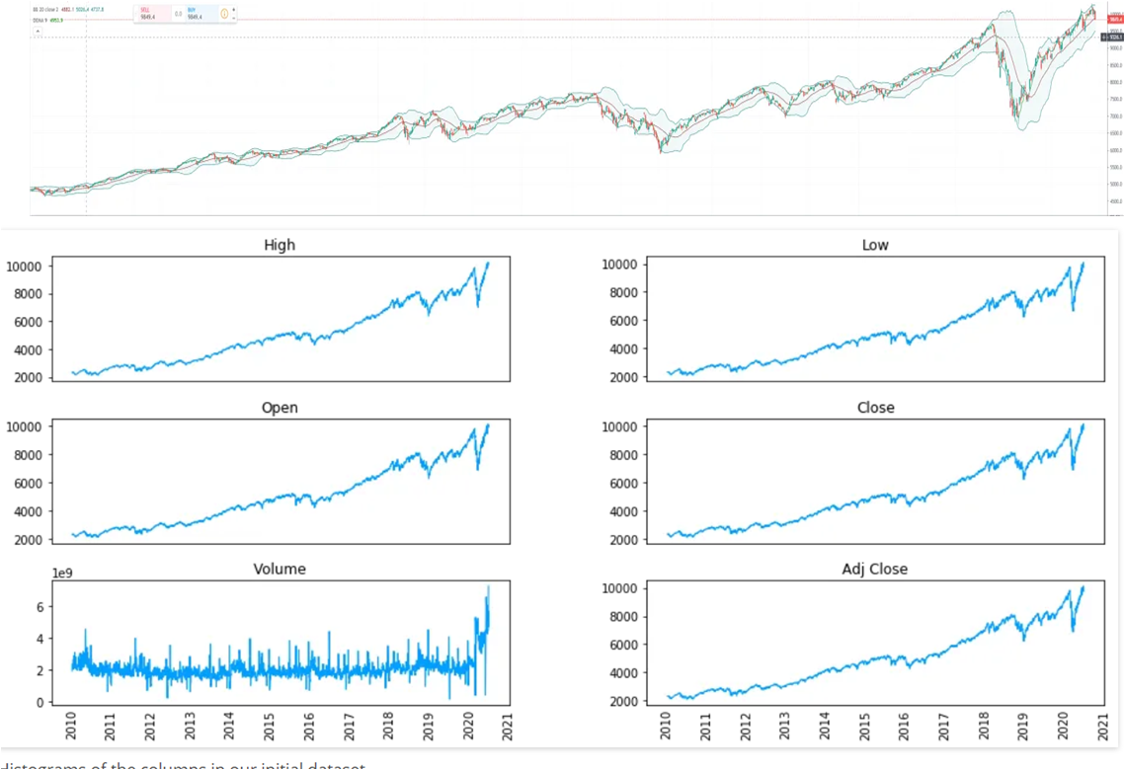
Feature Representation. Examples
Example - Build a Multivariate Time Series form the Univariate to estimate feature parameter importance

Slide 13
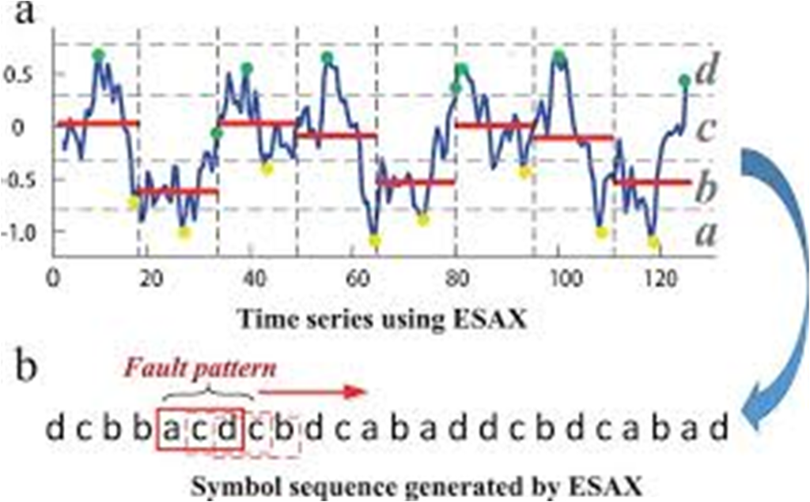
Feature Representation. Examples
Example of Symbol-Based (coarse quantization) Time Series Representation.

Slide 14
Time Series Transformations
Types of time series transformations:
Power Transform.
log-exp Transform.
Box-Cox Transformation.
Seasonal Difference.
Trend Difference.
Standardization.
Reversible filtration.
Normalization.

Slide 15
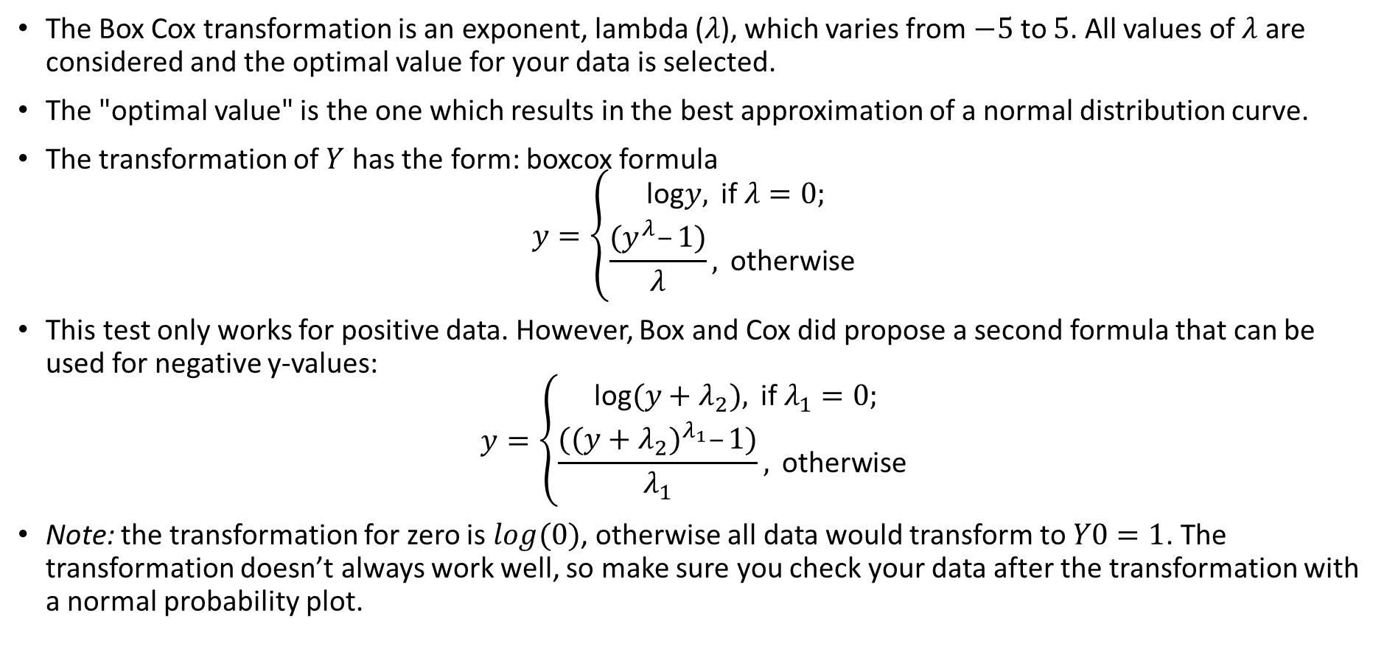
Time Series Transformations. The Box Cox transformation
The Box Cox transformation is an exponent, lambda ($λ$), which varies from $−5$ to $5$. All values of $λ$ are considered and the optimal value for your data is selected.
The "optimal value" is the one which results in the best approximation of a normal distribution curve.
The transformation of $Y$ has the form: boxcox formula
$$y=\left\{\begin{matrix}\text{log}y, \text{if} λ=0; \\ \frac{(y^{λ}–1)}{λ}, \text{otherwise} \end{matrix}\right.$$
This test only works for positive data. However, Box and Cox did propose a second formula that can be used for negative y-values:
$$y=\left\{\begin{matrix}\text{log}(y+λ_{2}), \text{if} λ_{1}=0; \\ \frac{({(y+λ_{2})}^{λ_{1}}–1)}{λ_{1}}, \text{otherwise} \end{matrix}\right.$$
Note: the transformation for zero is $log(0)$, otherwise all data would transform to $Y0=1$. The transformation doesn’t always work well, so make sure you check your data after the transformation with a normal probability plot.

Slide 16
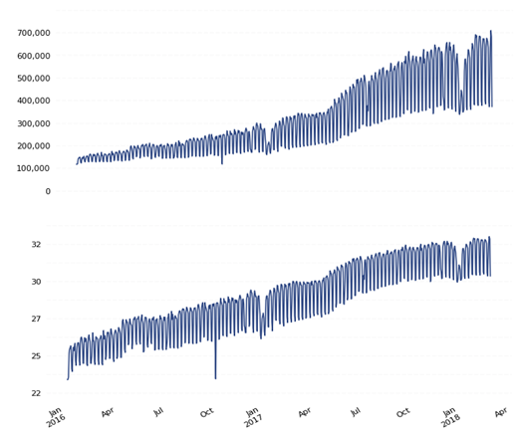
Time Series Transformations. The Box Cox transformation
Example of trend linearization using Box-Cox transform

Slide 17
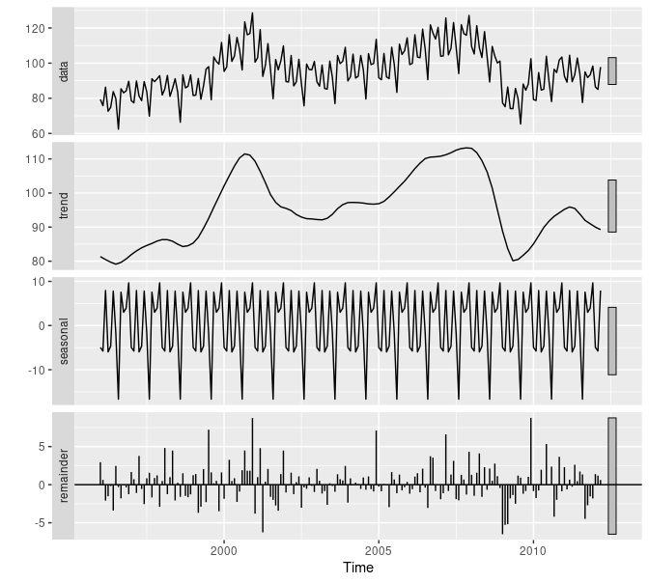
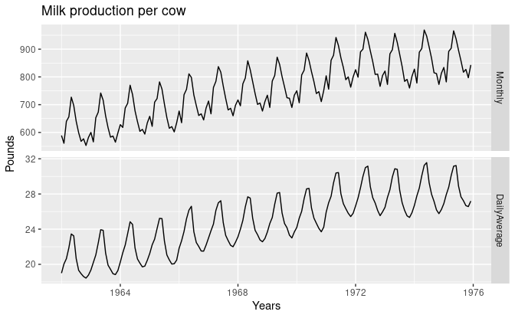
Feature Extraction. Examples
Example where the data are taken simply (upper case)
and with averaging by number of days in month
Example of STL - seasonal, trend decomposition,

Slide 18
Frequency domain representation
The time series can be also represented as its spectrum - i.e. in the frequency domain (in opposite to the time domain). For the series with unchanged trend behavior and other parameters the time and frequency representation will be equally informative. If there are exits behavior to time relation, than combined time-frequency representation can be applied.
Both the time and the frequency domains are allow to fully represent the series. In some cases frequency or time-frequency representation could be more convenient.

Slide 19
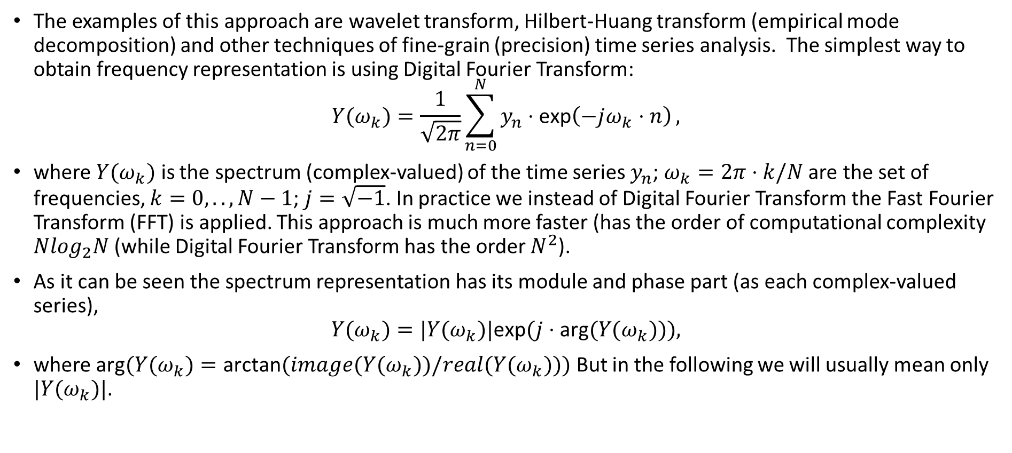
Frequency domain representation
The examples of this approach are wavelet transform, Hilbert-Huang transform (empirical mode decomposition) and other techniques of fine-grain (precision) time series analysis. The simplest way to obtain frequency representation is using Digital Fourier Transform:
$$Y(ω_{k})=\frac{1}{\sqrt{2π}}\sum_{n=0}^{N}{y_{n}⋅\text{exp}\left(−jω_{k}⋅n\right)},$$
where $Y(ω_{k})$ is the spectrum (complex-valued) of the time series $y_{n}$; $ω_{k}=2π⋅k/N$ are the set of frequencies, $k=0,..,N−1$; $j=\sqrt{−1}$. In practice we instead of Digital Fourier Transform the Fast Fourier Transform (FFT) is applied. This approach is much more faster (has the order of computational complexity $Nlog_{2}N$ (while Digital Fourier Transform has the order $N^{2}$).
As it can be seen the spectrum representation has its module and phase part (as each complex-valued series),
$$Y(ω_{k})=|Y(ω_{k})|\text{exp}(j⋅\text{arg}(Y(ω_{k}))),$$
where $\text{arg}(Y(ω_{k})=\text{arctan}(image(Y(ω_{k}))/real(Y(ω_{k})))$ But in the following we will usually mean only $|Y(ω_{k})|$.

Slide 20
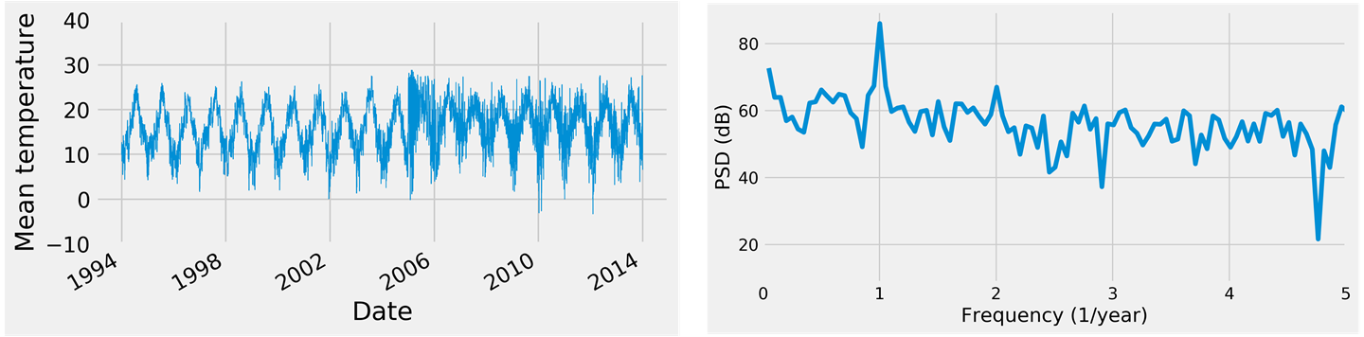
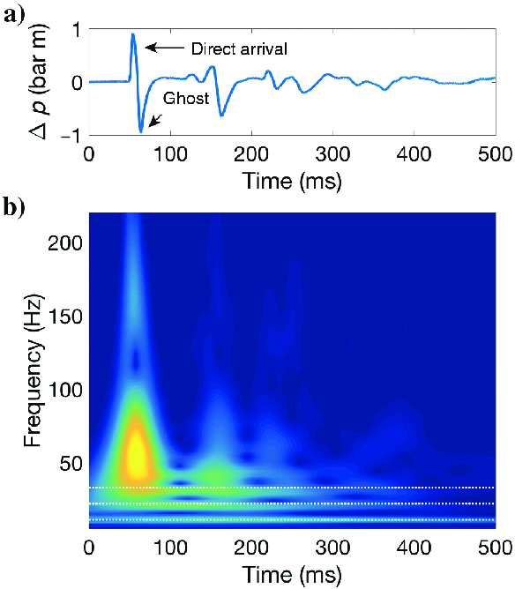
Frequency domain representation
By taken Spectrum with some moving window and time series we can obtain time-frequency (3-dimensional) representation of time series.

Slide 21
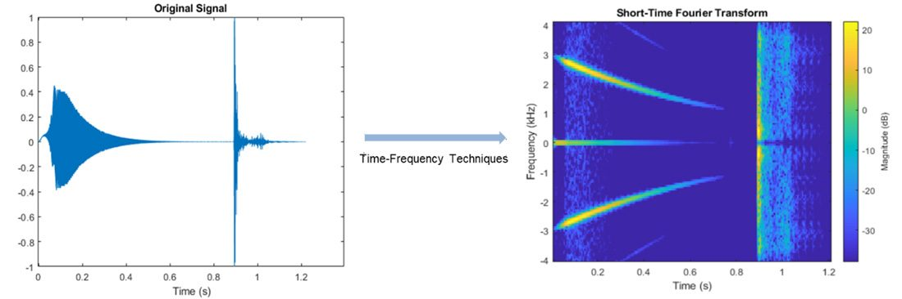
Frequency domain representation
note:In the frequency domain such "abstract" concepts as trend, seasonality and e.t.c. obtain there physical meaning. The trend (including cyclic part) is the most low-frequency part of the spectrum with relatively high intensity(amplitude). The level is the zero-frequency part of the spectrum. The seasonality is the relatively high-frequency part of the spectrum but with relatively small intensity(amplitude). The change of the series behavior mean change of its time-frequency representation behavior. Extracting some part of time series (i.e. trend or cyclic) is equal to low-pass filtration in frequency representation.
Example of time series short-Fourier transform representation

Slide 22
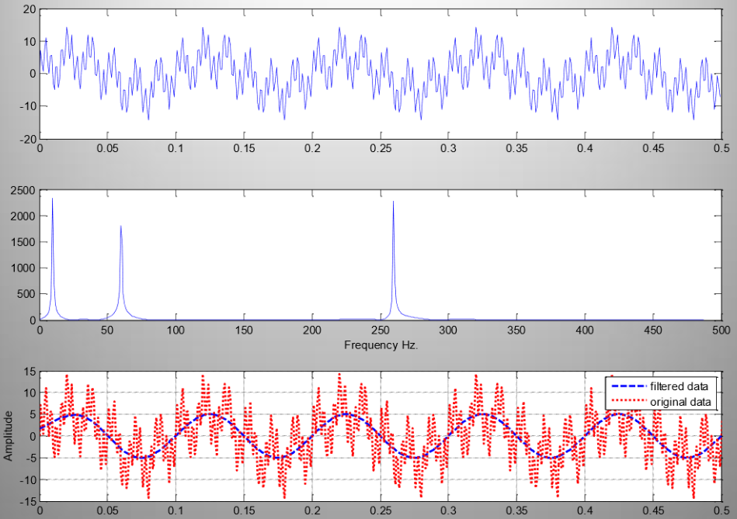
Frequency domain representation
Example of removing seasonal component using low-pass filtration in the spectrum domain

Slide 23
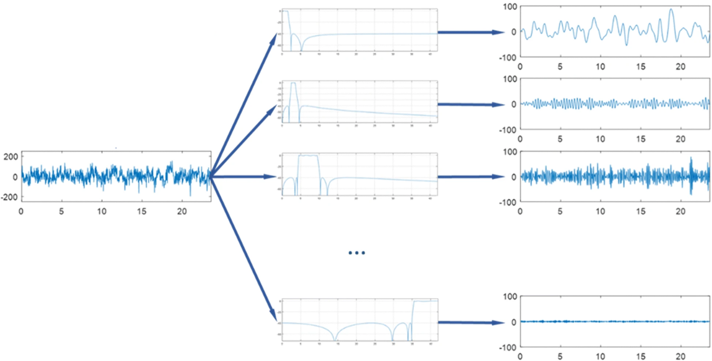
Feature Extraction. Examples
Example of feature extraction using filtration

Slide 24
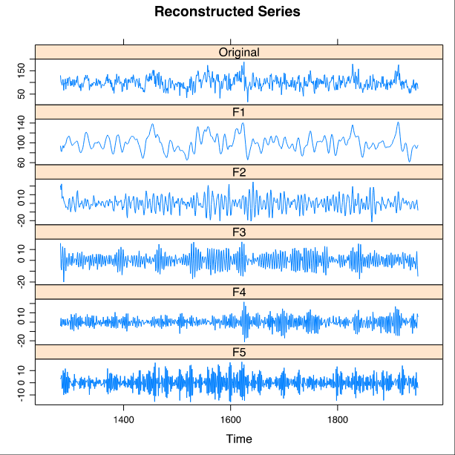
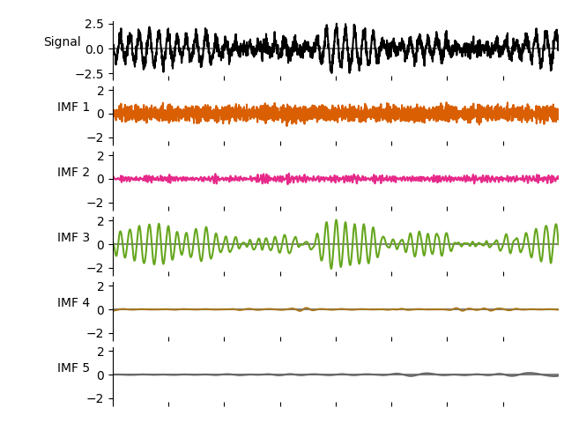
Feature Extraction. Examples
Example of feature extraction using Singular-SPectrum Analysis
Example of feature extraction using intrinsic mode decomposition and Hilbert-Huang transform

Slide 25
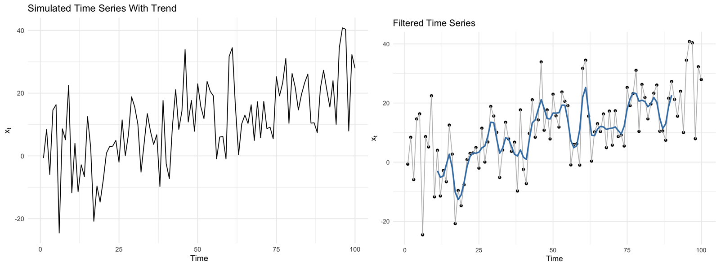
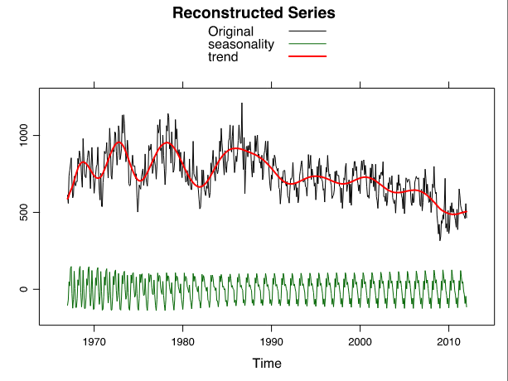
Feature Extraction. Examples
Example of time series low-frequency denoising
Example of feature extraction using Singular-SPectrum Analysis for complex trend extraction

Slide 26
Feature Selection
In scope of feature selection the technique are typically categorized into wrapper, filter and embedded, univariate and multivariate methods.
Wrapper methods use a predetermined learning algorithm to determine the quality of selected features according to an evaluation metric.
Filter methods apply (estimate) statistical measures to evaluate the set of attributes.
Embedded methods achieve model fitting and feature selection simultaneously.
Multivariate methods evaluate features in batches.
Univariate methods evaluate each feature independently.
The feature selection methods allowing:
Reduce Overfitting: Less redundant data means less opportunity to make decisions based on noise.
Improve Accuracy: Less misleading data means modeling accuracy improves.
Reduce Training Time and dimension (size): fewer data points reduce algorithm complexity and algorithms train faster.

Slide 27
Filtration based feature Selection
Filtration based feature selection - select subsets of features based on their relationship with the target.
Сorrelation analysis (cross-correlation, canonical-correlation analysis),
Mutual Information Feature Selection based on minimization (or maximization) of some measure, for instance, Kulback-Liber divergence or Mutual-entropy analysis, DICE over distributions and other.
Variance analysis (ANOVA, eigenvalues,).
Feature importance analysis (tree-based supervised method).

Slide 28
Feature Selection
Correlation analysis and Mutual Information
The methods are used as a measure linear dependency between pairs of variables (features).
For instance, correlation coefficient (cos-distance) in ranges between -1 to 1. It means, that values closer to 1 shows that they are highly correlated and value closer to -1 indicates that they are negatively correlated. As usual features with values above some threshold (±0.9±0.9) are ejected.
Also any other distance function can be applied instead of correlation (for instance Chi-Square, entropy, KL divergence or other).
Note. Features with high correlation are more linearly dependent and hence have almost the same effect on the dependent variable. So, when two features have high correlation, we can drop one of the two features.

Slide 29
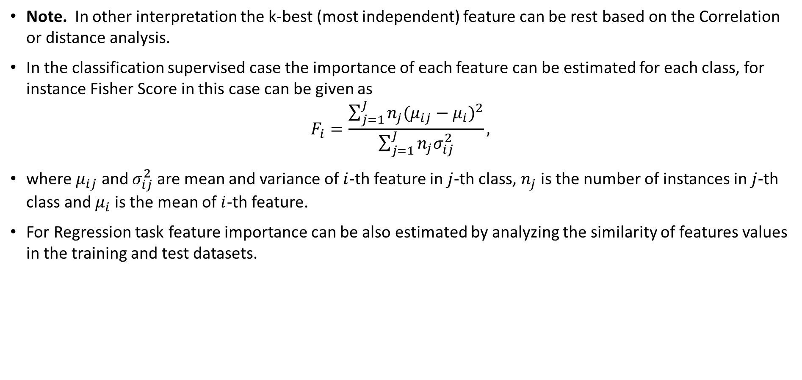
Feature Selection
Note. In other interpretation the k-best (most independent) feature can be rest based on the Correlation or distance analysis.
In the classification supervised case the importance of each feature can be estimated for each class, for instance Fisher Score in this case can be given as
$$F_{i}=\frac{\sum_{j=1}^{J}{n_{j}(μ_{ij}−μ_{i})^{2}}}{\sum_{j=1}^{J}{n_{j}σ_{ij}^{2}}},$$
where $μ_{ij}$ and $σ_{ij}^{2}$ are mean and variance of $i$-th feature in $j$-th class, $n_{j}$ is the number of instances in $j$-th class and $μ_{i}$ is the mean of $i$-th feature.
For Regression task feature importance can be also estimated by analyzing the similarity of features values in the training and test datasets.

Slide 30
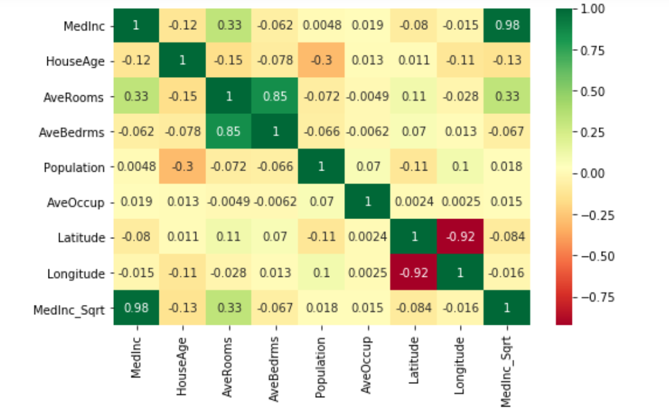
Feature Selection
Example of correlation based feature selection

Slide 31
Feature Selection. ANalysis Of VAriance (ANOVA)
ANOVA is a statistical method, used to check the means of two or more groups (features in time series that are significantly different from each other. It assumes Hypothesis on testing feature (or variable or column of data)
Null: Means of all groups are equal.
Alternate: At least one mean of the groups are different - we need this.
Specify of ANOVA
By using ANOVA we are want to determine the set of features which are explain (terms of) the variance of the data.
ANOVA allow one to select a set of features which mostly independent one form other and in sum produce full variance of the data.
Use ANOVA when you have one categorical feature and one numerical (like sex (Male, Female) and age 0-100 or like class labels and data).
In ANOVA we divide our features on the groups in correspondence with categorical feature (Male-Ages, Female-Ages).
For Feature (or variable) selection we test the hypothesis that distribution of this feature differs from other for each group.

Slide 32
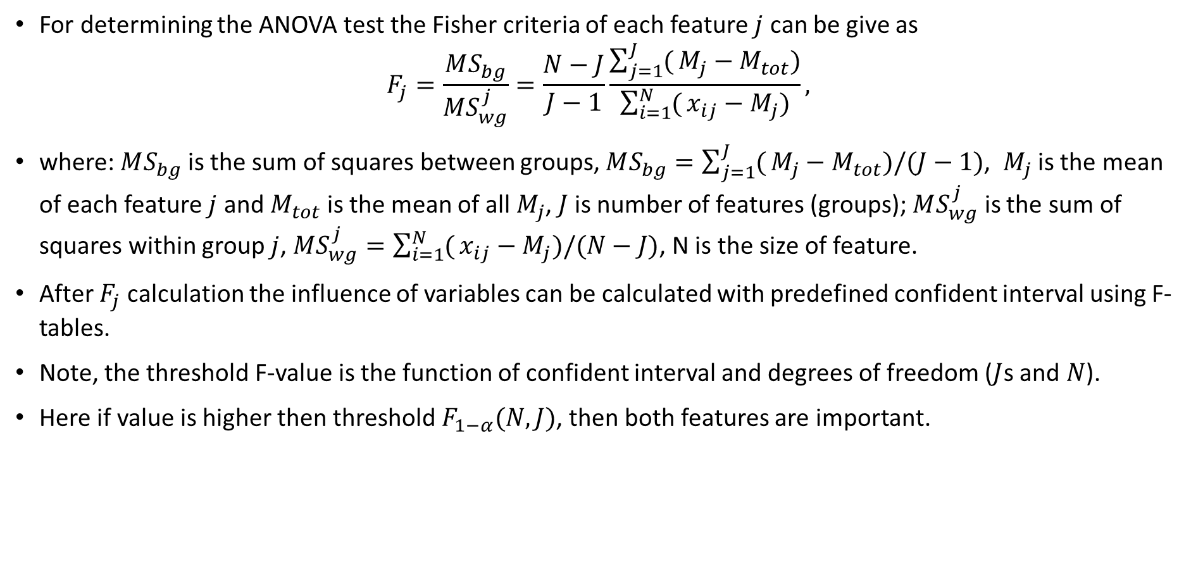
Feature Selection. ANalysis Of VAriance (ANOVA)
For determining the ANOVA test the Fisher criteria of each feature $j$ can be give as
$$F_{j}=\frac{MS_{bg}}{MS_{wg}^{j}}=\frac{N−J}{J−1}\frac{\sum_{j=1}^{J}{(}M_{j}−M_{tot})}{\sum_{i=1}^{N}{(}x_{ij}−M_{j})},$$
where: $MS_{bg}$ is the sum of squares between groups, $MS_{bg}=\sum_{j=1}^{J}{(}M_{j}−M_{tot})/(J−1)$, $M_{j}$ is the mean of each feature $j$ and $M_{tot}$ is the mean of all $M_{j}$, $J$ is number of features (groups); $MS_{wg}^{j}$ is the sum of squares within group $j$, $MS_{wg}^{j}=\sum_{i=1}^{N}{(}x_{ij}−M_{j})/(N−J)$, N is the size of feature.
After $F_{j}$ calculation the influence of variables can be calculated with predefined confident interval using F-tables.
Note, the threshold F-value is the function of confident interval and degrees of freedom ($J$s and $N$).
Here if value is higher then threshold $F_{1−α}(N,J)$, then both features are important.

Slide 33
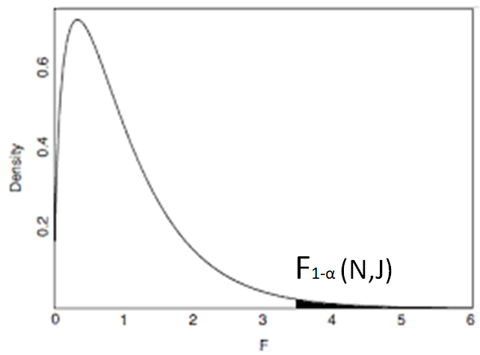

Feature Selection. ANalysis Of VAriance (ANOVA)
Note
In the case of two features ANOVA is analogue of t-test.
Beside ANOVA variance-based feature selection can be done using variance threshold.
Variance threshold method is based on the assumption that when a feature doesn’t vary much within itself, it generally has very little predictive power. Thus almost constant features can be eliminated.
The analogue of variance threshold is eigenvalues analysis and PCA
As a rule, ANOVA is used when one variable is numeric and one is categorical, such as numerical input variables and a classification target variable in a classification task.
ANOVA is analogue of t-test but allow to check dependencies between 2,3 or more features
Here if value is higher then threshold $F_{1−α}(N,J)$, then both features are important.

Slide 34
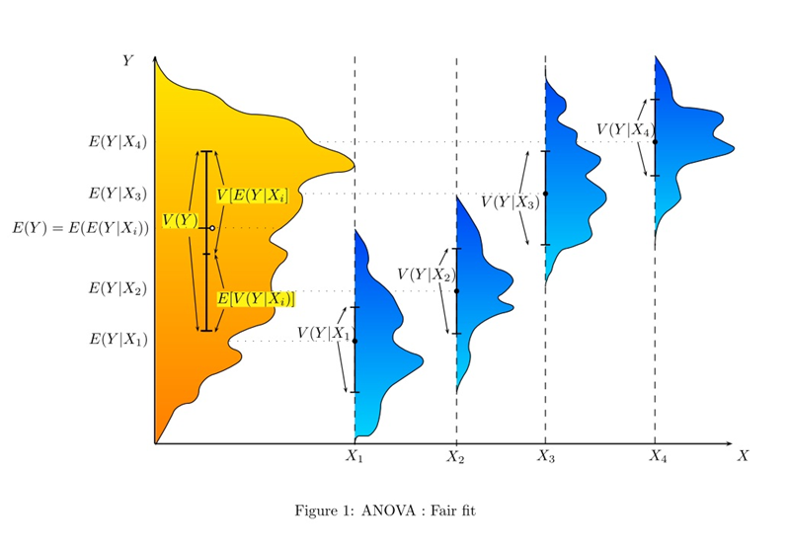
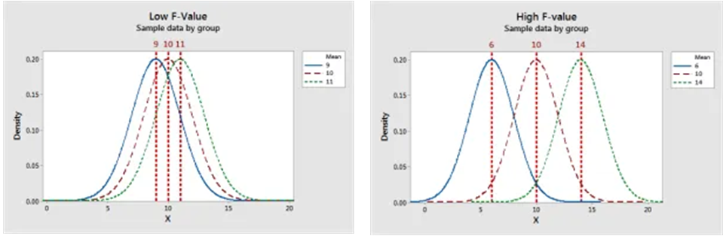
Feature Selection. ANalysis Of VAriance (ANOVA)
Example of case where features are important
Example of low-F-value (high coincidence, remove all expect one features) and high F-value (low coincidence, rest all features).

Slide 35
Feature importance feature Selection
The idea of the approach is to describe the feature relative importance to a model. After selecting the highest importance and eliminating weak features or combinations of features and re-evaluate to see if the model fairs are better during cross-validation.
In scikit-learn, Decision Tree models and ensembles of trees such as Random Forest, Gradient Boosting, and Ada Boost provide a `feature_importances_` attribute when fitted.
In general Gradient Boosting is better than Random Forest.

Slide 36
Feature importance
Most common way to select a feature by importance is to use tree-based methods
As a rule The feature importance are calculated based on Gini Index (Gini Impurity), Entropy or Chi-Square value.
Then higher the feature position in tree, than it more important (then it more decreases impurity).
Then more near split by feature to the tree trunk, than it more important (then it more decreases impurity).
The zero importance of feature mean that it is not used to split any nodes, and so we can remove it without affecting the model performance.
Correlated features show similar importance, so if one removes one of the correlated feature, the other feature shows grows of importance.
In theory of decision trees - then more a feature decreases impurity, more important the feature is.
Tree based models calculate feature importance for they need to keep the best performing features as close to the root of the tree. The approach is inverse of three-based anomaly detection.
The straightforward feature selection based on its importance not always provide correct results.
In some case it is recommended to make feature importance estimation iteratively, with change on of the feature (in cycle) to noise or with removing it for one iteration.

Slide 37
Feature importance
If Random Forest is used for feature selection the importance can be calculated using:
analysis of mean decrease in impurity (MDI, using sum of Gini impurity) for each feature;
mean decrease in accuracy (MDA) by replacing of feature (variable, column) on the noise with similar distribution
or by permutation (shuffle) its values (permutaed feature is almost the noise with the same distribution as the feature);
by performs on all variables at the same time and concatenates the noised features(shuffled) with the original ones (Boruta).
If gradient-boosting is used for feature selection the importance can be calculated using:
(LightGBM) importance_type (string, optional (default=split)) — How the importance is calculated. If split, result contains numbers of times the feature is used in a model. If gain, result contains total gains of splits which use the feature.
(XGBoost) weight — the number of times a feature is used to split the data across all trees. gain — the average gain of the feature when it is used in trees cover — the average coverage of the feature when it is used in trees, where coverage is defined as the number of samples affected by the split

Slide 38
Feature Selection. Wrapper methods
Wrapper methods are based on greedy search algorithms as they evaluate all possible combinations of the features and select the combination that produces the best result for a specific machine learning algorithm.
Step-Forward wrapper selection
Start with having no feature in the model.
In each iteration, search to adding the feature which best improves an accuracy
Repeat till an addition of a new variable does not improve the performance of the model or by the certain number of features are selected.
The best depends entirely on the defined by such evaluation criteria as AUC, prediction accuracy, RMSE, etc.
Stepwise/Subset Selection
The algorithm is similar to the forward selection process, but a variable can also be dropped if it’s deemed as not useful any more after a certain number of steps.

Slide 39
Feature importance. Wrapper methods
Step-Backwards wrapper selection (Recursive Feature Elimination, RFE)
Start with having all feature in the model.
In each iteration remove a feature that the smallest influence on the accuracy.
Repeat till find the optimal subset of a predefined size.
Exhaustive feature selection:
At each iteration repeatedly creates a several models (algorithm) and evaluate performance among all the possible combination of features.
Keeps aside the best or the worst performing feature at each iteration.
Ranks the features based on the order of their elimination.
Leave the best combination of the predefined size.

Slide 40
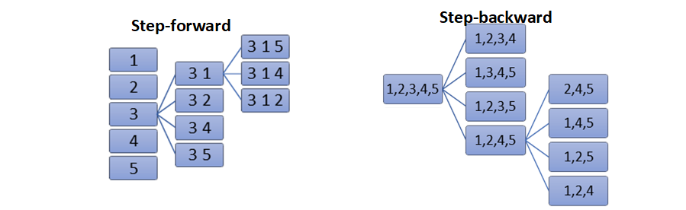
Feature importance. Wrapper methods
Illustration of wrapped methods
Note. Wrapper methods can be applied only for test (or validation) part. In this case instead of removing a feature we can replace it with random noise - feature column is still there, but it no longer contains useful information. This method works if noise is drawn from the same distribution as original feature values (as otherwise estimator may fail). The simplest way to get such noise is to shuffle values for a feature, i.e. use other examples’ feature values - this is how permutation importance is computed.

Slide 41
Feature importance. Embedded Method
Embedded Method is inbuilt variable selection method.
Use regularization (L1, L2, Elastic) for each feature during algorithm training.
frequently L1(Lasso) penalization is used here.
After training each feature obtain its own regularization weight.
Not important feature are given very low weight(close to zero).
Select the features with non-zero coefficients (or coefficient above some threshold or k-best feature).
Embedded technique is faster and less expensive than wrapper and more accurate than filter.
Pruning – make all weight less than threshold to zero and then use sparse matrix algorithms

